Slide 1
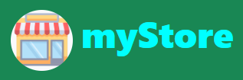
MYSTORE WEB site mini project one
GARRY M. CACHO, 44yo
An Electrical Engineer by day, and a C++ programmer by night
www.garrymcacho.com
Notes:
Good day everyone, specially to all the panelist and my fellow Kodegeeks.
Thank you for granting the time to be here.
I am glad to present to you the output of mini project 1 which is entitled
myStore Web Site.
By the way, I am Garry Cacho, 44years old, married for 11 years and a father of a 3 year old girl.

Slide 2
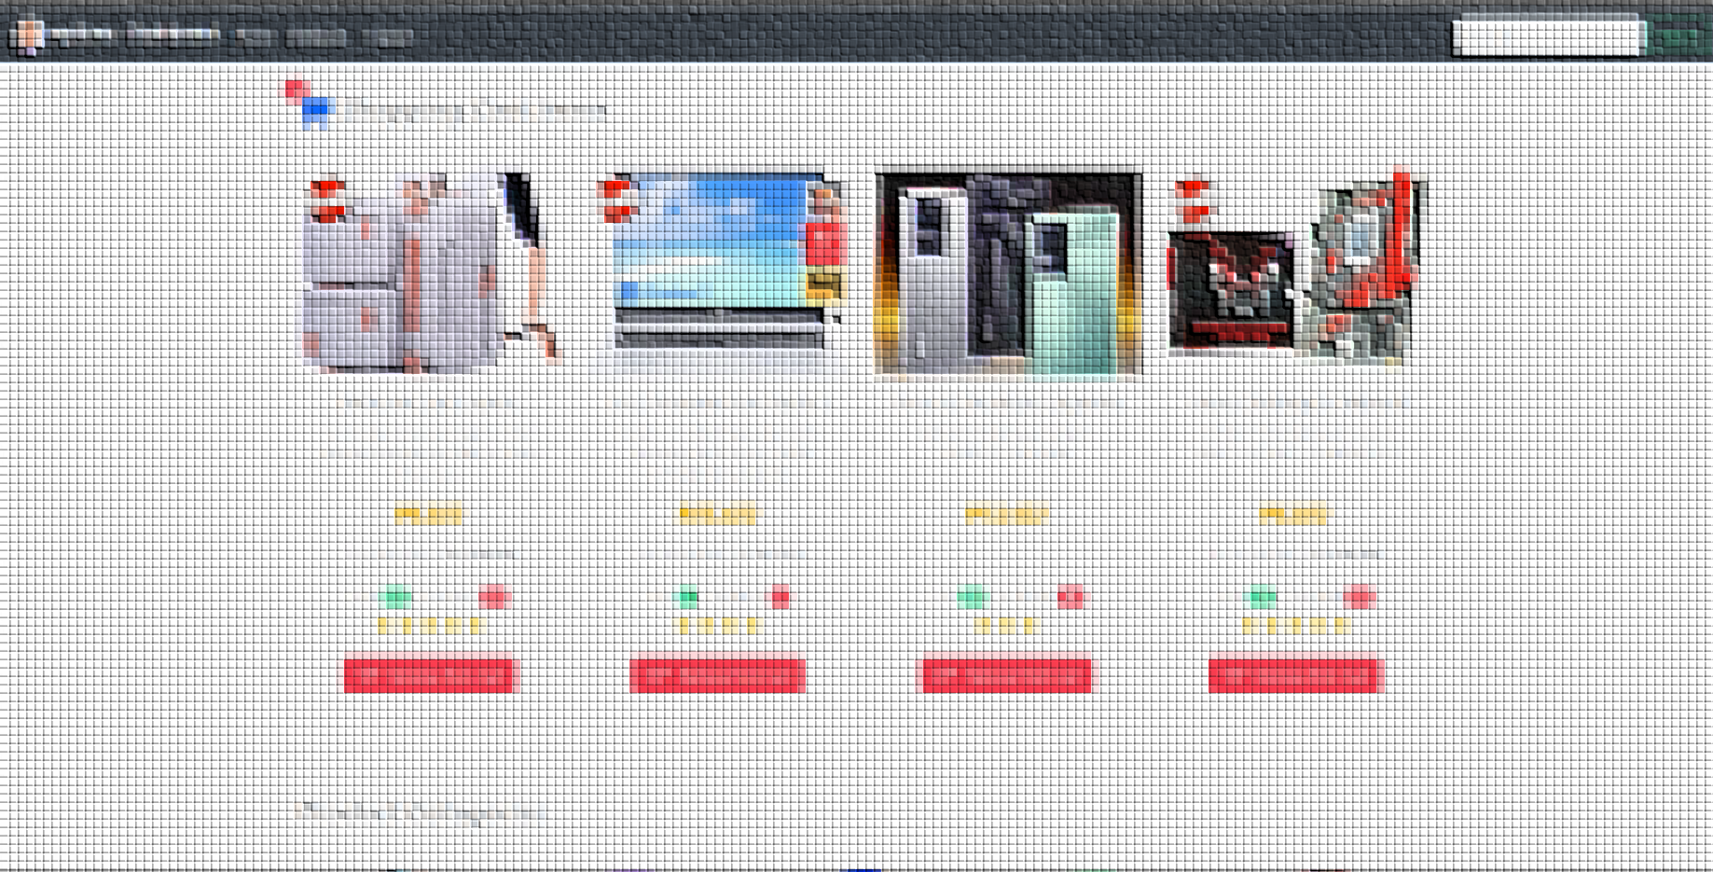
Brief Introduction
Notes:
Introduction

Slide 3
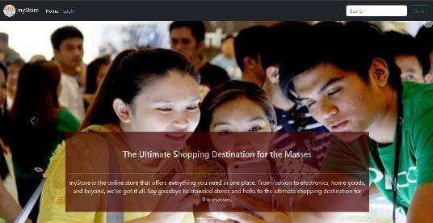
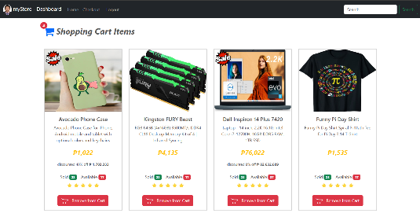
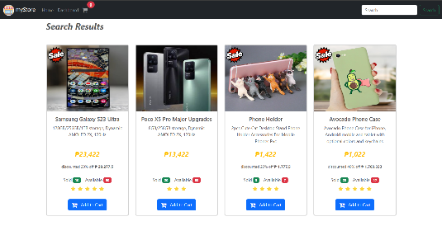
Modern and user-friendly online store web app
Mobile responsive design, accessible from any device.
Advanced product item search and filtering function
Notes:
myStore Web site, is a mock implementation of an online shopping web site with emphasis on user-friendliness, modern look and simplicity
Due to the use of bootstrap framework, the website is responsive.
It has also product search features, that enables the user to query the desired product using a search string.

Slide 4
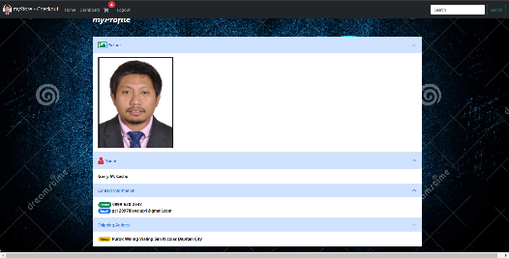
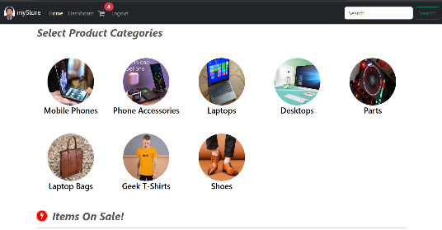
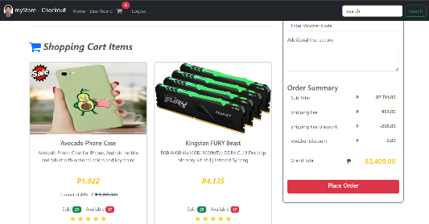
The web app has sign up, login, logout and user info features
Simple product categorization to make the app less cluttery
Clear representation of shopping cart and checkout
Notes:
Additionally, a security features is added that enable login and log out of the system.
And in order To simplify the products presentation, products are grouped into categories of similar properties.
It has also shopping cart and checkout mechanism, which is the basic component of an online store system.

Slide 5
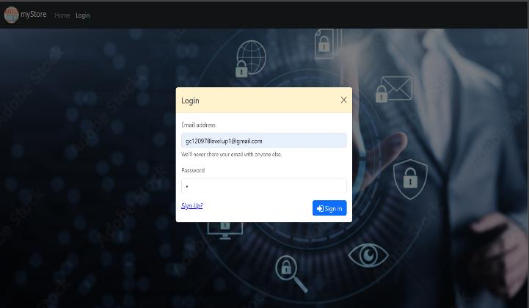
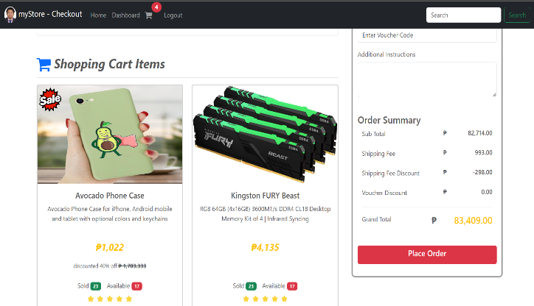
Objectives of the project
A handles employers requirement for basic e-commerce platform that can sell products and services.
To create a proof of concept on how to implement a simple online web app
Notes:
Objective:
Many businesses nowadays demand the need for a dedicated e-commerce platform that showcase their goods and services to the public.
Making this project can kickstart my experience in implementing e-commerce related application.
This project can be easily repurposed to showcase any product and service that requires online transaction.
And to create a proof-of-concept on how to implement the visualization, logic and data flow of a simple online shopping web site

Slide 6

DEVELOPMENT PROCESS

Slide 7
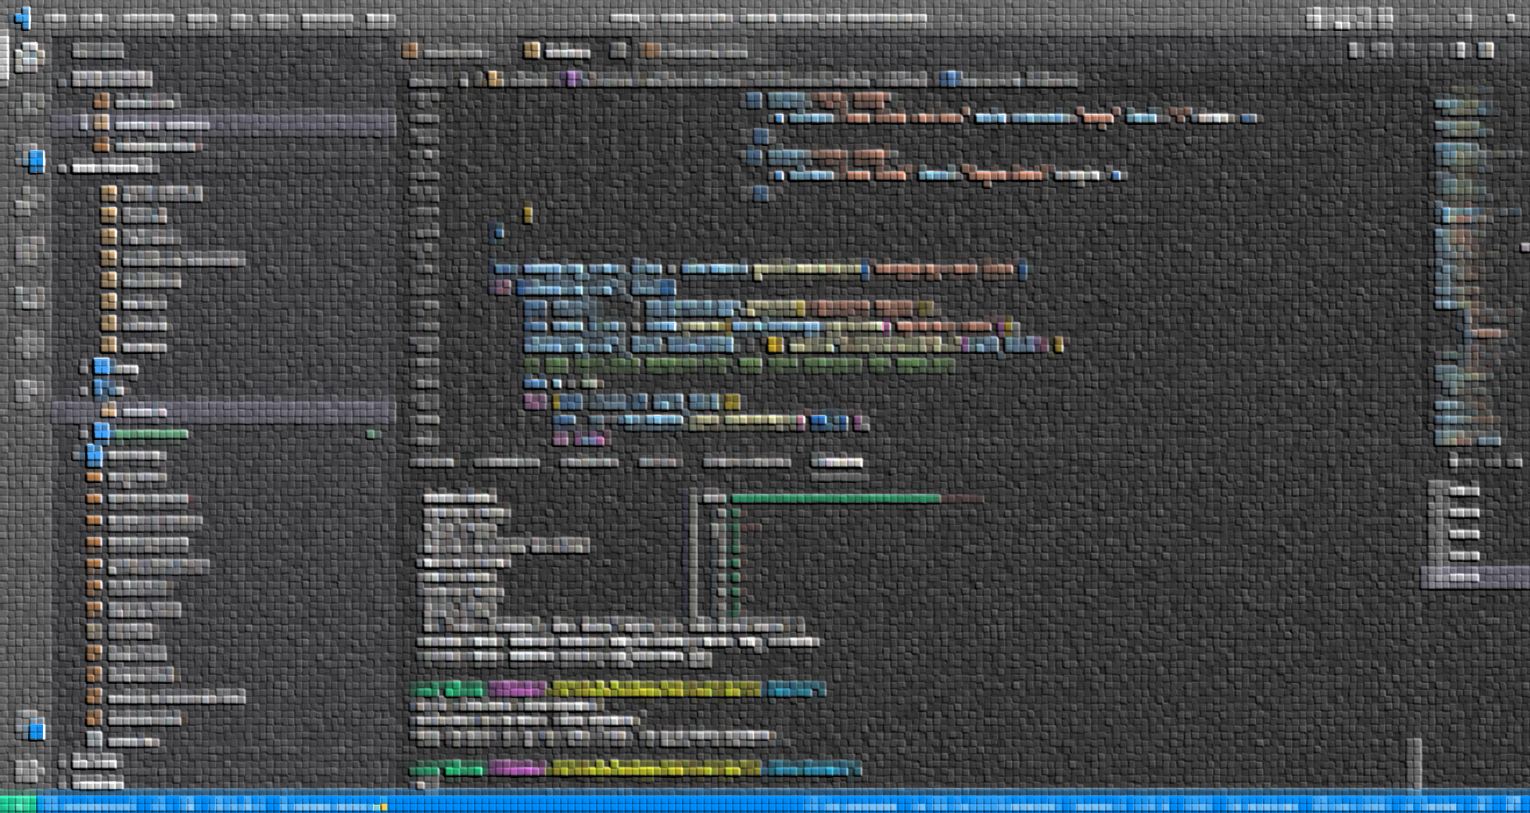
TechnologIES UTILIZED TO IMPLEMENT THE PROJECT
Notes:
First we will tackle the Technologies used

Slide 8





MODEL
JAVASCRIPT OBJECTS
VIEW
HTML, CSS, VANILLA JS, BOOTSTRAP 5
CONTROLLER
VANILLA JAVASCRIPT
Notes:
For the entirety of the project Implementation, I see to it that proper code segregation is adhered.
For data modeling mechanism I used javascript object arrays in order to describe the properties of each products, users and products category.
For viewing and visualization, I used the combination of html5, css, and bootstrap. I used vanilla javascript to dynamically render DOMs that relates to data objects.
And for basic controller, page routing and business logic obviously I used vanilla JS.

Slide 9








IDE
VS CODE w/ HTML-CSS, TABNINE, LIVE SERVER
VERSION CONTROL
GIT AND GITHUB, MINGW-CLI
WEB SERVICE
XAMPP, GITHUB-PAGES
Notes:
For IDE I used vscode with installed html css javascript code snippets, I also installed live server extension and tabnine for AI driven automatic code completion and intellisense since I did not yet really memorized most of the syntax
For version control, git and github is used together with mingw as the emulation of bash CLI.
For local web service I used xampp for local test deployent and for online deployment I used github pages.

Slide 10
GATHERING OF INFORMATION AND NECESSARY RESOURCES
Notes:
I gathered resources such as product images, descriptions, specs & online prices.

Slide 11
IDE
VS CODE w/ HTML-CSS, TABNINE, LIVE SERVER
VERSION CONTROL
GIT AND GITHUB, MINGW-CLI
WEB SERVICE
XAMPP, GITHUB-PAGES
Notes:
I gathered resources such as product images, descriptions, specs & online prices.

Slide 12
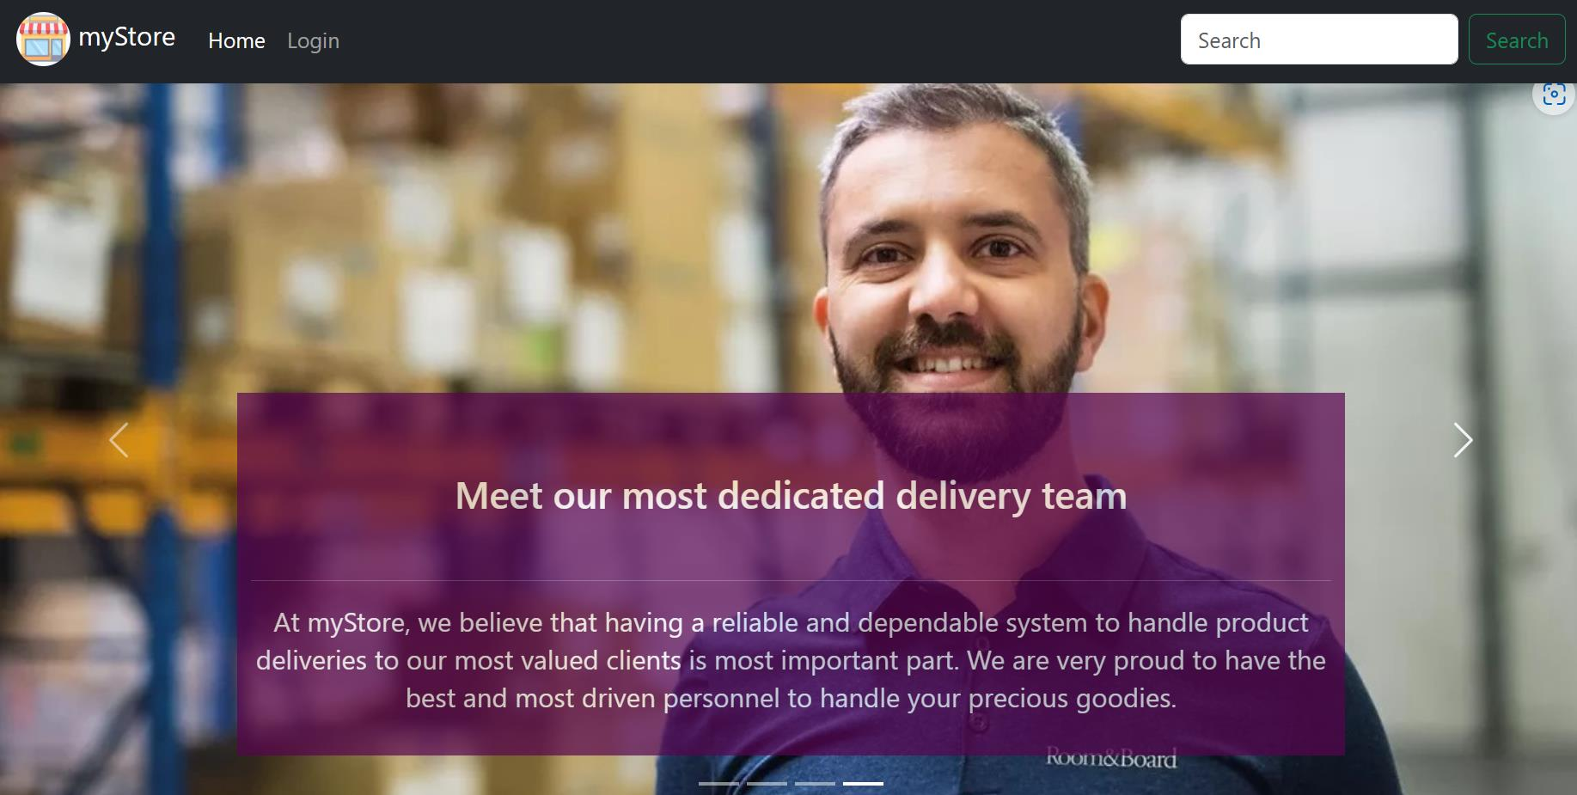
Use case diagram FOR UX DESIGN
Notes:
I created use case diagram and data flow diagram which are the old school equivalent of wire frame in UX Design
I used figma for the initial sketch of the UI design

Slide 13
myStore Online Shopping System
LOGIN
<<include>>
USER INFO
<<include>>
<<include>>
<<include>>
LOGOUT
REGISTERED CUSTOMER
SHOPPING CART
<<include>>
<<include>>
<<include>>
<<include>>
MAKE PURCHASE
<<include>>
CHECKOUT
VIEW PRODUCTS
<<include>>
NON-REGISTERED CUSTOMER
Notes:
In our use case,
We have 2 actors, namely registered customer and non-registered-customer
And 7 general use cases, namely login, shopping cart, view products, checkout, make purchase, user info, logout
Non-registered customer actor is granted access only to view products use case
Registered customer actor can access “view products” and “login” use case which is the portal to other remaining use cases.

Slide 14
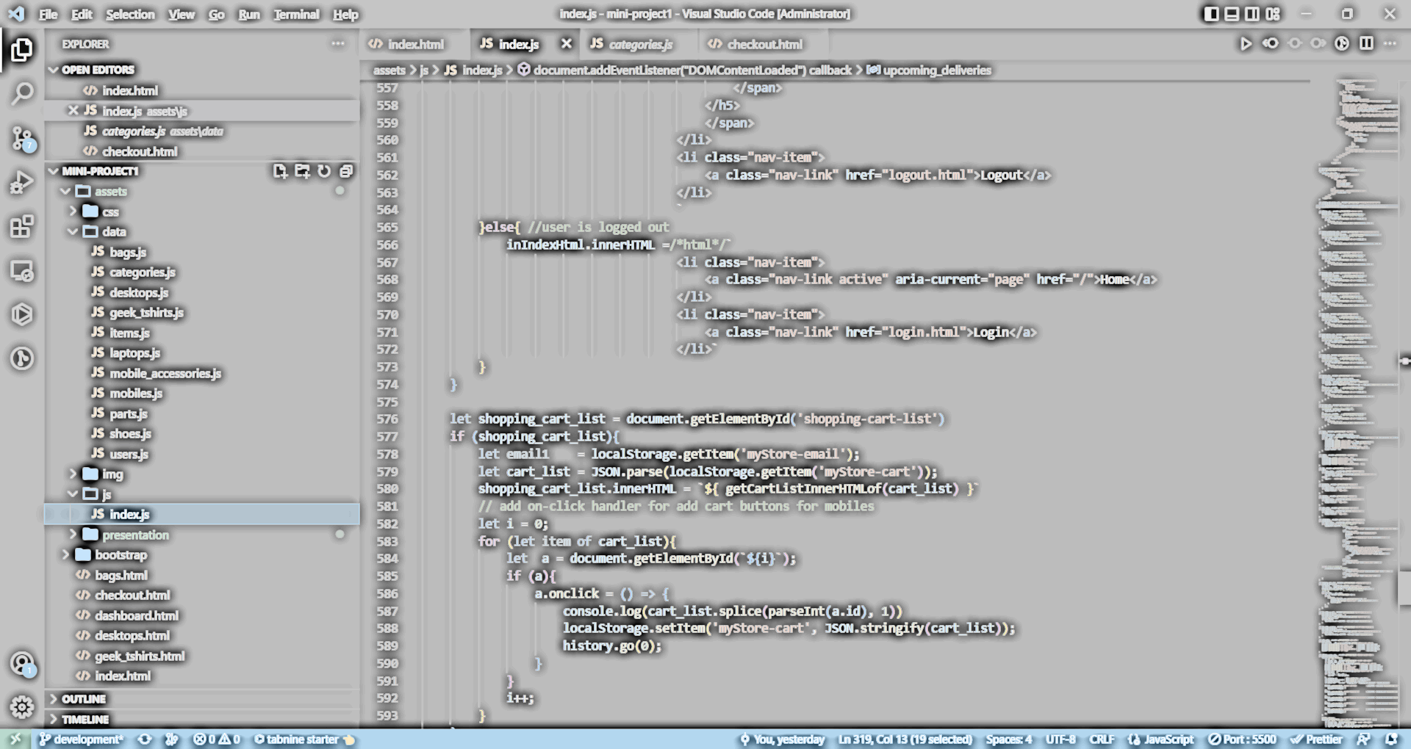
DATA FLOW diagram FOR UX DESIGN
Notes:
A data flow diagram (DFD) is a visual representation of how data flows within a system. It shows the inputs, processes, and outputs of a system, as well as the data stores and entities that interact with the system.
The basic components of a data flow diagram include:
Processes: These represent the functions or activities performed within the system. Each process takes inputs, performs some operation, and produces outputs.
Data Flows: These are the paths through which data moves between the different components of the system, such as processes, data stores, and entities.
Data Stores: These are the places where data is stored within the system, such as databases or files.
Entities: These are the external factors that interact with the system, such as users, customers, or other systems.

Slide 15
CUSTOMER
9.0
1.1
PROD SEARCH
ON SALE LIST
D1
LIST OF PRODUCTS
1.0
HOME
2.0
6.0
D2
LIST OF CATEGORIES
LOGIN
CATEGORY LIST
D3
LIST OF USERS
3.0
7.0
DASHBOARD
D3.1
LIST OF SHOPPING CART ITEMS
SHOPPING
CART
4.0
3.1
CHECKOUT
INCOMING
SHIPMENT
D3.2
LIST OF INCOMING SHIPMENT
5.0
8.0
PAYMENT
myPROFILE
Notes:
In this DFD
The Red rectangle represent an external system ( a human being behind a computer, or another distinct system)
The Blue bubbles represents sub system being used internally by the web site
The Black bubbles represents sub system that is dynamically rendered DOM based on its object data arrays
The Green rectangle represent the sub system that pre-stored object data arrays
The “Customer” has a default access to (1.0) home sub-system
1.0 Home sub-system has 2 dynamically rendered DOMs that takes its data from D1 and D2 respectively
2.0 Login sub-system - verify data from List of Users Data Object, D3
3.0 Dashboard sub-system - has 3 dynamically rendered DOMs that takes its data from D1, D2 and D3 respectively
4.0 Checkout sub-system – will sum up the price of the available items inside the user shopping cart item list
5.0 Payment sub-system - will accept payment input and transfer all the available items in the shopping cart to the list of incoming shipment
9.0 Product Search sub-system - filters the List of Products array with the input string

Slide 16
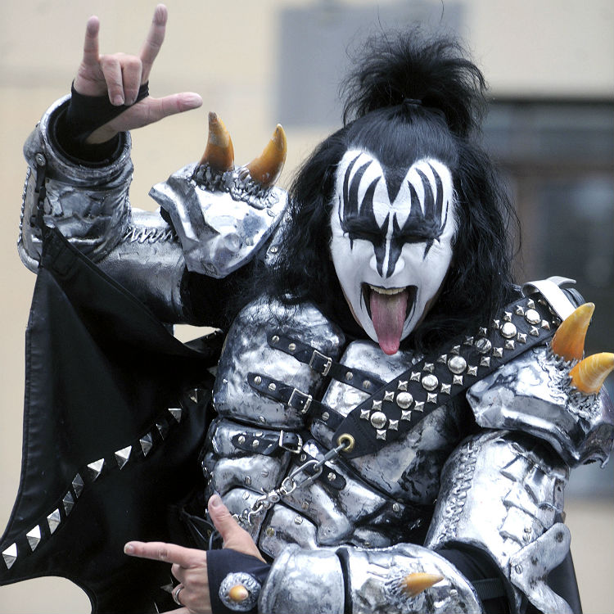








THANK YOU
Garry M. Cacho
gc120978levelup1@gmail.com
www.garrymcacho.com
Web Dev

